Slide 1
Critical Path
Task dependencies define a partial ordering among tasks, i.e.
  Completion of some tasks must precede the starting time of some other tasks.
A critical path:
  along which every milestone is critical to meeting the project deadline.
A Critical Path is a chain of tasks that determine the duration of the project.

Slide 2
Critical Paths
A critical paths is sequence of tasks such that
  a delay in any of the tasks will cause a delay to the entire project.
There can be more than one critical path in a project.
It is important for the project manager to be aware of the critical paths in a project:
  can ensure that tasks on these paths are completed on time.

Slide 3
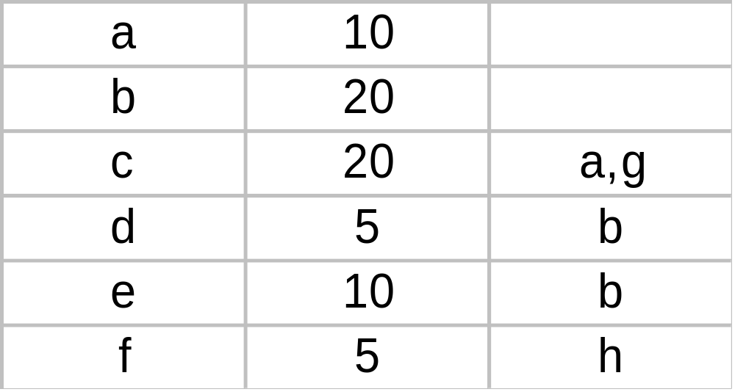
Task Table
Task Duration Dependents
g
7
-
h
11
d

Slide 4
CPM Graph
c:20
a:10
start
finish
g:5
b:20
f:5
d:10
e:10

Slide 5
How do we work out the various start and finish times for tasks?
Minimum time to complete project (MT) = Maximum of all paths from start to finish
Earliest start time (ES) of a task = Maximum of all paths from start to this task
Earliest finish time (EF) of a task = ES + duration of the task
Latest finish time (LF) of a task = MT - Maximum of all paths from this task to finish
Slack time = LS - ES = LF - EF

Slide 6
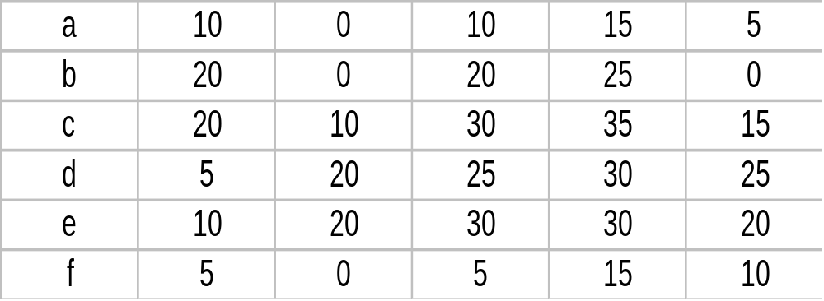
Start and finish times for tasks.
Latest start time (LS) of a task = LF - duration of the task
Task MT EF ES LF LS

Slide 7
What are the float time (or slack time) of tasks?
Float time (or slack time) is the total time that a task may be delayed
  before it will affect the end time of the project.
The float times indicate the "flexibility" in starting and completion of tasks:
A critical activity is an activity with zero (0) slack or float time.

Slide 8
What is PERT and how does it work?
PERT (Program Evaluation and Review Technique) is a variation of CPM:
  incorporates uncertainty about duration of tasks.
Gantt charts can be derived automatically from PERT charts.
Gantt chart representation of schedule is helpful in planning the utilization of resources,
  while PERT chart is more useful for monitoring the timely progress of activities.

Slide 9
Risk Management
A risk is any unfavourable event or circumstance:
  which might hamper successful or timely completion of a project.
Risk management:
  concerned with the reduction of the impact of risks.
Risk management consists of three activities:
  risk identification,
  risk assessment, and
  risk containment.

Slide 10
Risk identification
To be able to identify various risks:
  we must categorize risks into different classes.
Three main categories of risks can affect a software project:
  project risks
  technical risks
  business risks

Slide 11
Project Risks
Project risks associated with:
  budget,
  schedule,
  personnel,
  resource, and
  customer problems.

Slide 12
Technical Risks
Technical risks concern:
  requirements specification
    (e.g ambiguous, incomplete, changing specifications)
  design problems,
  implementation problems,
  interfacing problems,
  testing, and maintenance problems.
  technical uncertainty, and technical obsolescence are technical risk factors too.

Slide 13
Business Risks
Business Risks include:
  building an excellent product that no one wants,
  losing budgetary or personnel commitments, etc.
It is a good idea to have a “company disaster list”,
  a list of all bad things that have happened in the past
  project managers can jog their mind to see which items their project is vulnerable to.

Slide 14
Risk assessment
Objective of risk assessment is to prioritize the risks:
  Likelihood of a risk being real.
  Consequence of the problems associated with that risk.
Prioritization helps in handling the most damaging risks first.
  Priority of a risk is the product of the likelihood of the risk and the consequences of the problems associated with that risk.

Slide 15
Risk Handling
Three main strategies for risk handling:
  Avoid the risk: e.g. change the requirements for performance or functionality.
  Transfer the risk: allocate risks to third party
    or buy insurance to cover any financial loss should the risk become a reality.
  Contingency planning: Prepare contingency pans to minimize the impact of the risk.

Slide 16
Risk Handling
To decide about risk handling options, we must take into account:
  cost of reducing risk
  resulting cost saving from risk reduction.

Slide 17
Risk Containment
Let us see how we can contain an important type of risk:
  schedule slippage
    can be dealt with by increasing the visibility of the project.
Milestones are placed at regular intervals
  provide a manager with regular indication of progress.

Slide 18
Containing Schedule Slippage
A milestone is reached,
  when documentation produced has successfully been reviewed.

Slide 19
Software Configuration Management
The results (aka deliverables) of any large software development effort consists of a large number of objects:
  source code,
  design document,
  SRS document,
  test document,
  project plan (SPMP) document, etc.

Slide 20
Software Configuration Management (CONT.)
A configuration is a collection of deliverables:
  being developed for some customer.
As development proceeds,
  the components comprising a configuration undergo changes:
  Even during maintenance, the components comprising a configuration keep changing.

Slide 21
What is configuration management?
The set of activities through which the configuration items are managed and maintained
  as the product undergoes its life cycle phases.

Slide 22
Versions
A configuration for a particular system is called a version:
  The initial delivery might consist of several versions,
  more versions might be added later on.
  For example, one version of a mathematical package might run on a Unix machine,
    another on Windows NT, and
    another on Solaris.

Slide 23
Versions
As a software is released and used by the customers:
  errors are discovered,
  enhancements to the functionalities might be needed.
A new release of the software is an improved system intended to replace an old one.
Usually a product is described as version m and release n (or as version m.n)

Slide 24
Software Configuration Management
Existence of variants of a software product causes several problems.
Suppose you have several versions of the same module, and
  find a bug in one of them.
  it has to be fixed in all versions.

Slide 25
Software Configuration Management
Different objects are accessed and modified by a number of engineers.
Unless strict discipline is enforced:
  regarding updation and storage of the objects through some automated tool,
  several problems appear.

Slide 26
Software Configuration Management
For example, an engineer might update the module that he has designed ---
  without informing the engineers who need to interface with this module.
Or, two engineers may simultaneously carry out changes to different portions of a module:
  while saving overwrite each other.

Slide 27
Why Configuration Management?
To be able to identify the exact state of different deliverables at any time.
To avoid the problems associated with having replicated objects accessible by multiple engineers.
Controlling concurrent work on a module by different engineers. (Overwriting one engineer’s work by another)
Letting different engineers work on related modules at the same time.
Keeping track of variants (versions) and helping fix bugs in them.
Storing versions and revisions efficiently.
Maintaining revision history (accounting).

Slide 28
Software Configuration Management
Configuration management helps to:
  quickly determine the current state of the product
  change the various components (modifications, revisions, variations etc.) in a controlled manner.
  maintaining the current up-to-date status of various versions of the software,
  control and account changes to the product.

Slide 29
Baseline
A baseline is the status of all the objects under configuration control. When any of the objects under c control is changed, a new baseline gets formed.
It may be archived periodically(copying to a safe place) so that the last baseline can be recovered in case of disaster.

Slide 30
Software Configuration Management Activities
Configuration management is carried out through three principal activities:
  configuration identification,
  configuration control,
  configuration accounting and reporting.

Slide 31
Software Configuration Management Activities
Configuration identification
  which parts of the system must be kept track of?
Configuration control
  ensures that changes to a component happen smoothly.
Configuration accounting
  keeps track of what has been changed, when, and why.

Slide 32
Configuration Identification
Deliverable objects can be classified into three main categories:
  controlled,
  precontrolled,
  uncontrolled.
Controlled objects are under configuration control:
  you must follow some formal procedures to change them.

Slide 33
Configuration Identification
Precontrolled objects are not yet under configuration control,
  but may eventually be under configuration control.
Uncontrolled objects are not and will not be subject to configuration control.

Slide 34
Configuration Identification
Typical controllable objects include:
  Design documents
  Tools used to build the system, such as compilers, linkers, lexical analyzers, parsers, etc.
  Source code for each module
  Test cases
  Problem reports

Slide 35
Configuration Control
Configuration control is the process of managing changes.
  It is the part of configuration management that most directly affects day-to-day operations of the developers.
Once an object goes under configuration control,
  any further changes requires approval from a change control board (CCB).

Slide 36
Configuration Control
The CCB is constituted from among the development team members.
For every change carried out,
  CCB certifies several things about the change:
    Change is well-motivated.
    Developer has considered and documented the effects of change.
    Appropriate people have validated the change.

Slide 37
Configuration Control
An important reason for configuration control:
  people need a stable environment to develop a software product.
Suppose you are trying to integrate module A, with the modules B and C,
  you cannot make progress if developer of module C keeps changing it;
  this is especially frustrating if a change to module C forces you to recompile A.
As soon as a document under configuration control is updated,
  the updated version is frozen and is called a baseline.

Slide 38
Configuration Control
Baseline
New Baseline
A
B
A
B
C
D
C’
D
Reserve
Replace
Cancel Reservation
C
Private Copy

Slide 39
Configuration Control
This establishes a baseline for others to use.
Freezing a configuration may involve archiving everything needed to rebuild it.
  Archiving means copying to a safe place such as a magnetic tape.
At any given time, a programmer may pay attention to:
  Current baseline configuration
  Programmer's private version

Slide 40
SCCS (Source Code Control System)
SCCS is a configuration management tool:
  available on Unix systems:
  helps control and manage text files.
  also implements an efficient way of storing versions:
    minimizes the amount of occupied disk space.

